Slide 1
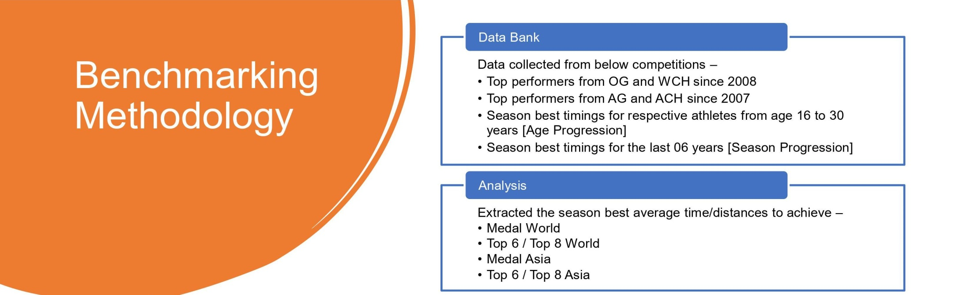
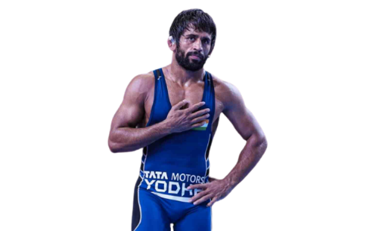
How performance assessment of wrestlers are done?
Performance assessment of wrestlers are done based on the points system devised by TOPS.
While being inducted in TOPS, Wrestlers in the Olympic weight categories are given priority along with Wrestlers who are at or nearing their High Performance Age.
Name : Bajrang Punia (TOPS CORE)
Event : 65 Kg Freestyle
Coach: Sujeet Maan
DOB: 26/02/1994 (28 Years), HPA:22-28
Training Base : SAI Sonipat
Best Performance: 2020 Tokyo OG Bronze, 4 time (1S, 3 B) WCH medallist
Current world rank : 5
Bajrang Punia’s predicted performance for upcoming major events.
Event | Gold | Silver/Bronze | Bronze
2024 Paris Olympic Games |  | ✔
Asian Games 2022 |  | ✔
Commonwealth Games 2022 | ✔

Slide 2
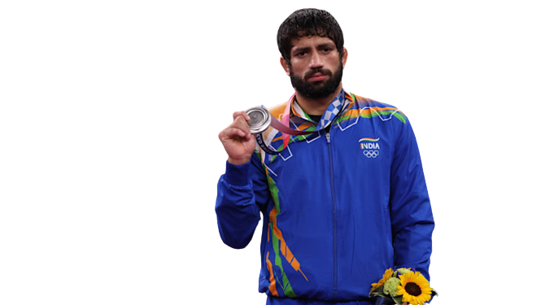
How performance assessment of wrestlers are done?
Performance assessment of wrestlers are done based on the points system devised by TOPS.
While being inducted in TOPS, Wrestlers in the Olympic weight categories are given priority along with Wrestlers who are at or nearing their High Performance Age
Name : Ravi Kumar (TOPS CORE)
Event : 57 kg Freestyle
Coach: Jagminder/ Arun
DOB: 12/12/1997 (24 Years)
Training Base : SAI Sonipat/Chattrasal
Best Performance: 2020 Tokyo Olympics Silver, 2019 World Championship Bronze
Current world rank : 2
Ravi Kumar’s predicted performance for upcoming major events.
Event | Gold | Silver/Bronze | Effective Participation
2024 Paris Olympic Games |  | ✔
Asian Games 2022 | ✔
Commonwealth Games 2022 | ✔

Slide 3
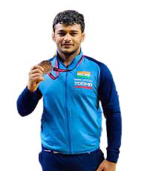
How performance assessment of wrestlers are done?
Performance assessment of wrestlers are done based on the points system devised by TOPS.
While being inducted in TOPS, Wrestlers in the Olympic weight categories are given priority along with Wrestlers who are at or nearing their High Performance Age
Name : Deepak Punia (TOPS CORE)
Event : 86 kg Freestyle
Coach: Virender
DOB: 19/05/1999 (22 Years)
Training Base : SAI Sonipat
Best Performance: 2019 World Championship Silver Medallist
Current world rank : 9
Deepak Punia’s predicted performance for upcoming major events.
Event | Gold | Silver/Bronze | Effective Participation
2024 Paris Olympic Games |  |  | ✔
Asian Games 2022 |  | ✔
Commonwealth Games 2022 | ✔

Slide 4
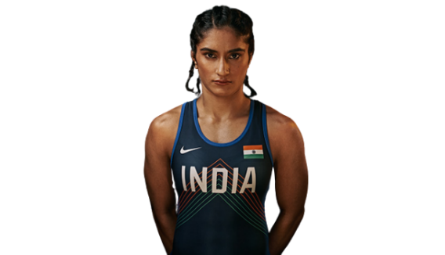
Name : Vinesh Phogat (TOPS CORE)
Event : 53 kg Women’s Wrestling
Coach: Somvir Rathee
DOB: 25/08/1994 (27 Years)
Training Base : SAI Lucknow
Best Performance: 2019 & 2022 World Championship Bronze, 2018 Asian GamesGold
Current world rank : 22
Vinesh Phogat’s predicted performance for upcoming major events.
Event | Gold | Silver/Bronze | Effective Participation
2024 Paris Olympic Games |  |  | ✔
Asian Games 2022 |  | ✔
Commonwealth Games 2022 | ✔

Slide 5
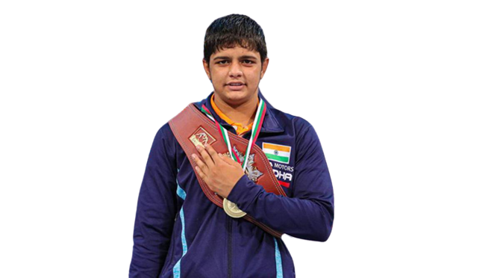
How performance assessment of wrestlers are done?
Performance assessment of wrestlers are done based on the points system devised by TOPS.
While being inducted in TOPS, Wrestlers in the Olympic weight categories are given priority along with Wrestlers who are at or nearing their High Performance Age
Name : Sonam Malik (TOPS CORE)
Event : 62 Kg Women Wrestling
Coach: Ajmer Malik
DOB: 15/04/2002 (20 Years)
Training Base: SAI Lucknow
Best Performance: 2019 Cadet WCH Gold
Current world rank : 31
Sonam Malik’s predicted performance for upcoming major events.
Event | Gold | Silver/Bronze | Effective Participation
2024 Paris Olympic Games |  |  | ✔
Asian Games 2022 |  |  | ✔
Commonwealth Games 2022 | ✔

Slide 6
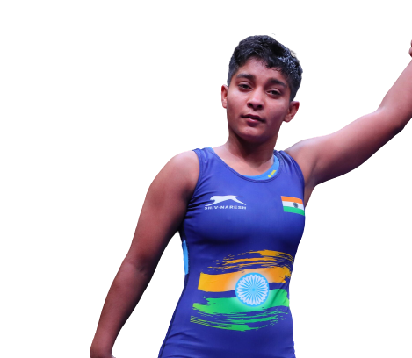
Name : Sanju Devi(TOPS Development)
Event : 59/ 62Kg Women’s Wrestling
DOB/Age: 12/01/2002 (20 Years)
Age at 2028 Olympics: 26 (High Performance Age)
Training Base : SAI Lucknow/Karnal
Best Performance: 2021 Jr. World Championship Silver Medallist
Latest performance at International: Gold at Dan Kolov Nikola Petrov Tournament (5 Competitors entered her weight category). (The competition has been classified as lesser competition as per TOPS assessment.)
Sanju Devi’s predicted performance for 2028 Olympics.
Event | Effective Participant | Participant | Others | Need time to assess
2028 LA Olympic Games |  |  |  | ✔ (Still early days in her senior career)
Position at last Sr. Nationals (2021) | Position at last Jr. Nationals | Position at last Open Nationals | Position at last Jr. WCH | Position at last Cadet WCH | Position at Sr. ACH 2022 | Latest performance
DNP | DNP in 2022, Gold in 2021 | 1 | 2 | NA | DNQ (Was injured during trials for ACH) | Lost in CWG selection trials to Sakshi Malik 7-0

Slide 7
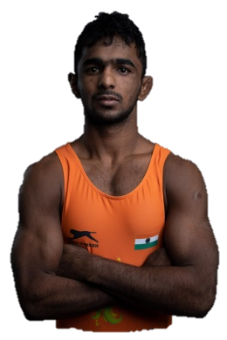
Name : Arjun Halakurki (TOPS Development)
Event : 55/60 Kg GR
DOB/Age: 10/07/1998 (23 Years)
Age in 2028 Olympics: 29 (Not High Performance Age)
Training Base : SAI Sonipat/Army Sports Institute, Pune
Best Performance: 3rd 2021 Ranking Series Italy
Latest performance at International: 3rd at 2022 Asian Championship
Arjun Halakurki predicted performance for 2028 Olympic Games
Event | Effective Participant | Participant | Others | Need time to assess
2028 LA Olympic Games |  |  | ✔
Position at last Sr. Nationals (2021) | Position at last Jr. Nationals | Position at last Open Nationals | Position at last Jr. WCH | Position at last Cadet WCH | Position at Sr. ACH 2022 | Latest performance
1 | NA | DNP | NA | NA | 3 | 3rd at ACH losing to 2019 WCH medalist by TSU.

Slide 8
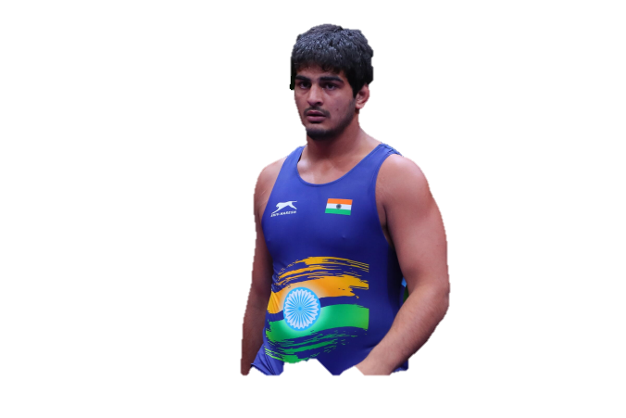
Name : Anirudh Kumar(TOPS Development)
Event : 125 Kg FS
DOB/Age: 20/01/2002 (20Years)
Age in 2028 Olympics: 26 (High Performance Age)
Training Base : SAI Sonipat/Chatrasaal Stadium, New Delhi
Best Performance: 2021 Jr. World Championship Bronze Medallist
Latest performance at International: 7th at 2022 Asian Championship (9 Competitors entered)
Position at last Sr. Nationals (2021) | Position at last Jr. Nationals | Position at last Open Nationals | Position at last Jr. WCH | Position at last Cadet WCH | Position at Sr. ACH 2022 | Latest performance
DNP | 2nd | DNP | 3rd | NA | 7 | Lost to relatively unknown S. Korean Wrestler in first round at 2022 ACH.

Slide 9
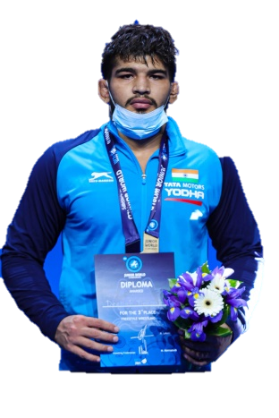
Name : Deepak (TOPS Development)
Event : 97 Kg FS
DOB/Age: (20 Years)
Age in 2028 Olympics: 26 (High Performance Age)
Training Base : SAI Sonipat/Mirchpur Shaheed Bhagat Singh kusti Academy, Hissar
Best Performance: 2021 Jr. World Championship Bronze Medallist, 2022 CWG Bronze
Latest performance at International: 3rd 2021 Jr. World Championship
Sunil Kumar predicted performance
Event | Effective Participant | Participant | Others | Need time to assess
2028 LA Olympic Games |  |  |  | ✔
Position at last Sr. Nationals (2021) | Position at last Jr. Nationals | Position at last Open Nationals | Position at last Jr. WCH | Position at last Cadet WCH | Position at Sr. ACH 2022 | Latest performance
3 | DNP | DNP | 3 | NA | DNQ | Won CWG trials by defeating Sahil by TSU in finals.

Slide 10
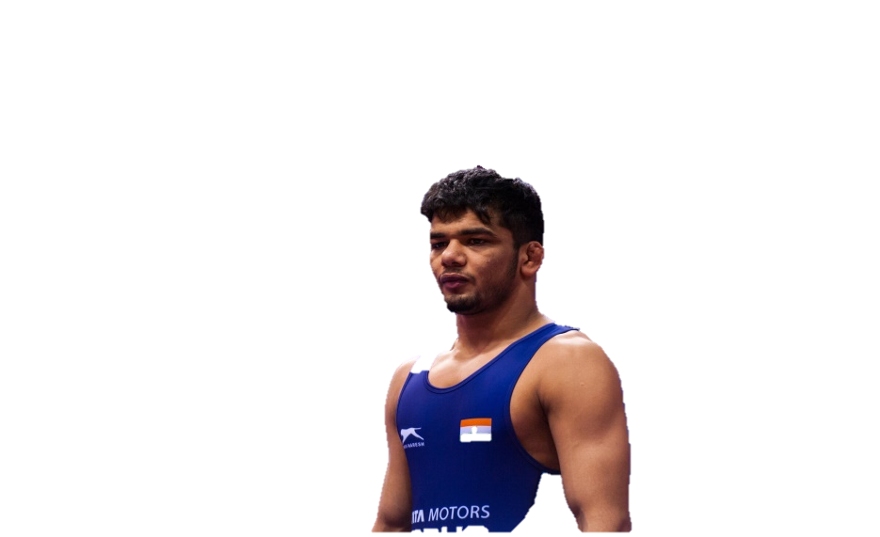
Name : Yash Tushir (TOPS Development)
Event : 74 Kg FS
DOB/Age: 27/08/2002 (19 Years)
Age in 2028 Olympics: 25 (High Performance Age)
Training Base : SAI Sonipat/Anil maan Akhada alipur, Delhi
Best Performance: 2021 Jr. World Championship Bronze Medallist
Latest performance at International: Lost to 2016 OG Bronze medalist in first round at 2022 ACH by 11-10.
Yash Tushir’s predicted performance for 2028 LA
Event | Effective Participant | Participant | Others | Need time to assess
2028 LA Olympic Games |  |  |  | ✔
Position at last Sr. Nationals (2021) | Position at last Jr. Nationals | Position at last Open Nationals | Position at last Jr. WCH | Position at last Cadet WCH | Position at Sr. ACH 2022 | Latest performance
2 | NA | DNP | 3 | NA | 3 | Lost in CWG trials to Vijay by 3-2.

Slide 11
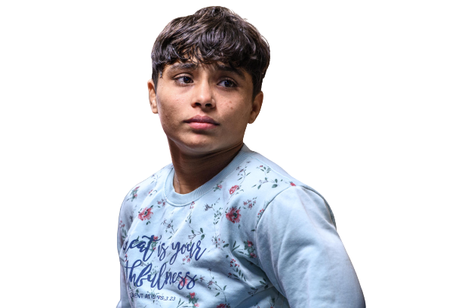
Name : Hanny Kumari (TOPS Development)
Event : 50 Kg Women’s Wrestling
DOB/Age: 14/01/2001(21 Years)
Age in 2028 Olympics: 27 (High Performance Age)
Training Base : SAI Lucknow/Nidani, Haryana
Best Performance: 2019 Cadet WCH Bronze
Last performance at International: 10th at 2021 Sr. World Championship out of 20 Wrestlers.
Hanny Kumari ’s predicted performance
Event | Effective Participant | Participant | Others | Need time to assess
2028 LA Olympic Games |  |  |  | ✔
Position at last Sr. Nationals (2021) | Position at last Jr. Nationals | Position at last Open Nationals | Position at last Jr. WCH | Position at last Cadet WCH | Position at Sr. ACH 2022 | Latest performance
DNP | NA | 2 | DNP | NA | DNQ | Bronze at Khelo India University Games 2022. Suffered elbow injury during competition.

Slide 12
Name : Sarita (TOPS Development)
Event : 57/59Kg Women’s Wrestling
DOB/Age: 16/04/1995 (27 Years)
Age in 2028 Olympics: 33 Years (Not High performance Age)
Training Base : SAI Lucknow/ Balgarh, Sonipat
Best Performance: 3rd at 2021 World Championship
Latest performance at International:Gold at 2nd Ranking Series in Kazakhstan (5 competitors entered)
Sarita’s predicted performance for 2028
Event | Effective Participant | Participant | Others | Need time to assess
2028 LA Olympic Games |  |  | ✔
Position at last Sr. Nationals (2021) | Position at last Jr. Nationals | Position at last Open Nationals | Position at last Jr. WCH | Position at last Cadet WCH | Position at Sr. ACH 2022 | Latest performance
1 | NA | DNP | NA | NA | 3 | Lost to Anshu in CWG selection trials final by 2-1.

Slide 13
Sarita Mor’s performance in last 5 International Events

Slide 14
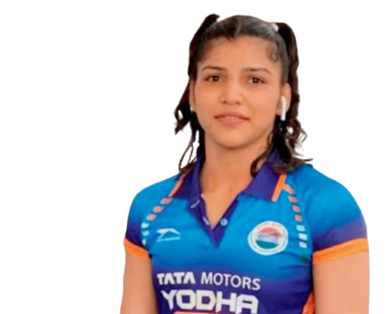
Name : Nisha (TOPS Development)
Event : 65/68Kg Women’s Wrestling
DOB/Age: 19/09/1998 (23 Years)
Age in 2028 Olympics: 29 Years (High Performance Age)
Training Base : SAI Lucknow/Karnal
Best Performance: Bronze at 2021 U-23 World Championship
Last performance at International: Forfeited 2022 ACH due to injury. 3rd at 2021 U-23 WCH.
Nisha’s predicted performance
Event | Effective Participant | Participant | Others | Need time to assess
2028 LA Olympic Games |  |  |  | ✔
Position at last Sr. Nationals (2021) | Position at last Jr. Nationals | Position at last Open Nationals | Position at last Jr. WCH | Position at last Cadet WCH | Position at Sr. ACH 2022 | Latest performance
1 | NA | DNP | NA | NA | Debarred from playing ACH trials. | Lost to Divya Karan in CWG Trials final by TSU.

Slide 15
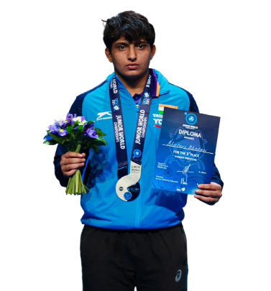
Name : Bhateri (TOPS Development)
Event : 65/68Kg Women’s Wrestling
DOB/Age: 05/11/2001 (20 Years)
Age in 2028 Olympics: 27 Years (High Performance Age)
Training Base : SAI Lucknow/ Bhiwani
Best Performance: 2nd JR. WCH 2021
Last performance at International: Lost in 1st round at 2021 WCH by 8-0 to Russian Wrestler.
Bhateri’s predicted performance
Event | Effective Participant | Participant | Others | Need time to assess
2028 LA Olympic Games |  |  |  | ✔
Position at last Sr. Nationals (2021) | Position at last Jr. Nationals | Position at last Open Nationals | Position at last Jr. WCH | Position at last Cadet WCH | Position at Sr. ACH 2022 | Latest performance
No medal | DNP | 1 | 2 | NA | DNQ | Lost to Radhika at CWG trials by 10-0.

Slide 16
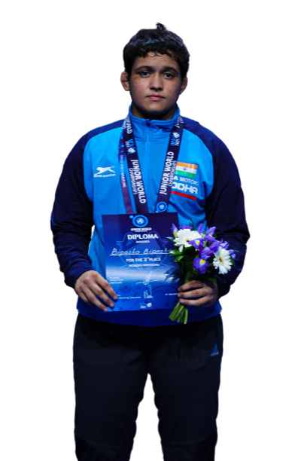
Name : Bipasha (TOPS Development)
Event : 76Kg Women’s Wrestling
DOB/Age: 1/09/2002 (19 Years)
Age in 2028 Olympics: 25 Years (High Performance Age)
Training Base : SAI Lucknow/Yudhveer Akhara Sonipat
Best Performance:2nd 2021 Jr. WCH
Latest performance at International: 8th 2021 U-23 World Championship. (14 Wrestlers competed)
Bipasha’s predicted performance
Event | Effective Participant | Participant | Others | Need time to assess
2028 LA Olympic Games |  |  |  | ✔
Position at last Sr. Nationals (2021) | Position at last Jr. Nationals | Position at last Open Nationals | Position at last Jr. WCH | Position at last Cadet WCH | Position at Sr. ACH 2022 | Latest performance
3 | 2 | DNP | 2 | NA | DNQ | Lost by fall to Pooja Sihag in CWG trials final.

Slide 17
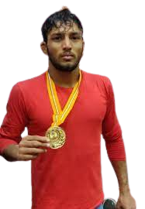
Name : Rohit (TOPS Development)
Event : 61/65 Kg Wrestling
DOB/Age: 19 (Years)
Age in 2028 Olympics: 25 Years (High Performance Age)
Training Base : SAI Sonipat, Shaheed Bhagat Singh Akhara Rohtak
Best Performance: Gold 2021 National Championship
Last performance at International: 5th at 2021 World Championship
Rohit’s predicted performance for 2028 Olympics
Event | Effective Participant | Participant | Others | Need time to assess
2028 LA Olympic Games |  |  |  | ✔
Position at last Sr. Nationals (2021) | Position at last Jr. Nationals | Position at last Open Nationals | Position at last Jr. WCH | Position at last Cadet WCH | Position at Sr. ACH 2022 | Latest performance
1 | DNP | DNP | DNP | NA | DNQ (Lost to Bajrang in selection trials final 3-2) | Lost to Surjit in CWG trials by 2-1.

Slide 18
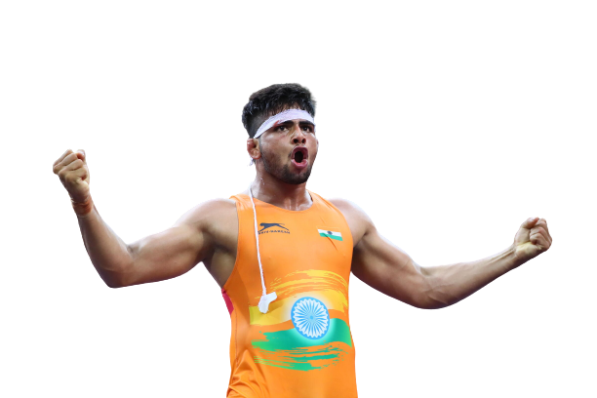
Name : Sajan (TOPS Development)
Event : 77Kg GR
DOB/Age: 17/01/1999 ( 23 Years)
Age in 2028 Olympics: 29 (High Performance Age)
Training Base : SAI Lucknow/Karnal
Best Performance: 2022 U-23 World Championship Bronze
Latest performance at International: 5th at 2022 Asian Championship ( 8 Wrestlers Competed)
Sajan’s predicted performance for 2028 Olympic Games
Event | Effective Participant | Participant | Others | Need time to assess
2028 LA Olympic Games |  |  | ✔
Position at last Sr. Nationals (2021) | Position at last Jr. Nationals | Position at last Open Nationals | Position at last Jr. WCH | Position at last Cadet WCH | Position at Sr. ACH 2022 | Latest performance
1 | NA | DNP | NA | NA | 5 | Defeated Sonu in recent trials for 2nd Ranking Series by 5-0.

Slide 19
Sajan’s (77Kg GR) performance in last 2 years
Injured (Did not play)
Out of 16 competitors
Out of 8 competitors
Out of 12 competitors
Out of 13 competitors
Out of 31 competitors
Out of 22 competitors
Out of 26 competitors

Slide 20
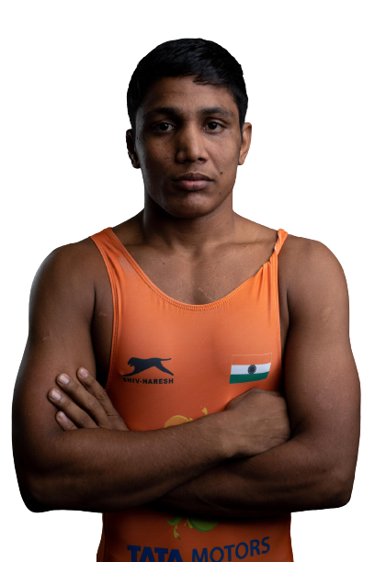
Name : Gaurav Baliyan (TOPS Development)
Event : 74Kg/79Wrestling
DOB/Age: 1/10/2001(21 Years)
Age in 2028 Olympics: 27 Years (High Performance Age)
Training Base : SAI Sonipat
Best Performance: 2022 Asian Championship Silver
Latest performance at International: 2022 Asian Championship Silver
Gaurav’s predicted performance
Event | Effective Participant | Participant | Others | Need time to assess
2028 LA Olympic Games |  |  |  | ✔
Position at last Sr. Nationals (2021) | Position at last Jr. Nationals | Position at last Open Nationals | Position at last Jr. WCH | Position at last Cadet WCH | Position at Sr. ACH 2022 | Latest performance
1 | DNP | DNP | DNP | NA | 2 | Lost in CWG trials final against Naveen 12-2

Slide 21
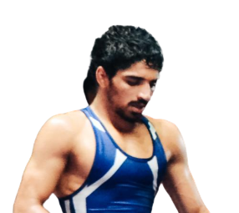
Name : Aman Sehrawat (TOPS Development)
Event : 57 Kg FS
DOB/Age: 16/07/2003 (18Years)
Age in 2028 Olympics: 24 Years (High Performance Age)
Training Base : SAI Sonipat/ Chhatrasal
Best Performance: 2022 U-23 World Championship Gold
Latest performance at International:3rd in Ranking Series in Turkey, 2022
Aman’s predicted performance
Event | Effective Participant | Participant | Others | Need time to assess
2028 LA Olympic Games | ✔
Position at last Sr. Nationals (2021) | Position at last Jr. Nationals | Position at last Open Nationals | Position at last Jr. WCH | Position at last Cadet WCH | Position at Sr. ACH 2022 | Latest performance
1 | DNP | DNP | DNP | NA | DNQ( Gave walkover to Ravi Kumar in final of trials) | Lost to Ravi Kumar in CWG trials final by Technical Superiority.

Slide 22
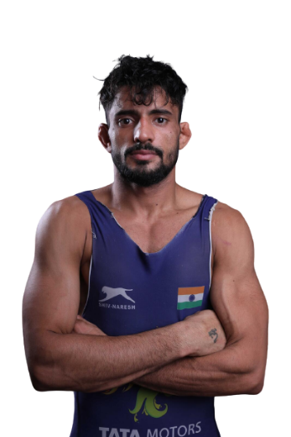
Name : Ashu (TOPS Development)
Event : 67 Kg GR
DOB/Age: 09/05/2000 (22 Years)
Age in 2028 Olympics: 28Years (High Performance Age)
Training Base : SAI Sonipat/ Pratap School Kharkhoda
Best Performance: 2020 Asian Championship Bronze
Latest performance at International:11th in Ranking Series in Turkey, 2022 (12 Competitors entered)
Ashu’s predicted performance
Event | Effective Participant | Participant | Others | Need time to assess
2028 LA Olympic Games |  |  | ✔
Position at last Sr. Nationals (2021) | Position at last Jr. Nationals | Position at last Open Nationals | Position at last Jr. WCH | Position at last Cadet WCH | Position at Sr. ACH 2022 | Latest performance
1 | NA | DNP | NA | NA | DNQ(Lost in trials to Sachin Sehrawat) | Lost in ACH 2022 trials final to Sachin Sehrawat.

Slide 23
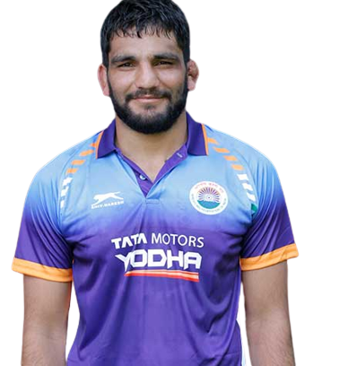
Name : Sunil Kumar(TOPS Development)
Event : 87 Kg GR
DOB/Age: 29/09/1999 (22Years)
Age in 2028 Olympics: 28 (High Performance Age)
Training Base : SAI Sonipat/Guru mehar Akhara Rohtak
Best Performance: 2020 Asian Championship Gold
Latest performance at International: 3rd at 2022 Asian Championship
Sunil Kumar predicted performance for 2028
Event | Effective Participant | Participant | Others | Need time to assess
2028 LA Olympic Games |  |  | ✔
Position at last Sr. Nationals (2021) | Position at last Jr. Nationals | Position at last Open Nationals | Position at last Jr. WCH | Position at last Cadet WCH | Position at Sr. ACH 2022 | Latest performance
1 | NA | DNP | NA | NA | 3 | 3rd at ACH losing to 2019 WCH medalist by TSU.

Slide 24
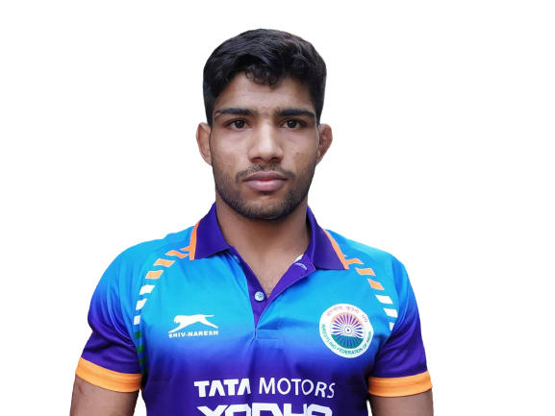
Name : Ravinder (TOPS Development)
Event : 61/65 Kg FS
DOB/Age: 03/08/1997 (24Years)
Age in 2028 Olympics: 30 (Not High Performance Age)
Training Base : SAI Sonipat/Naresh Akhara Delhi
Best Performance: 2019 U-23 World Championship Silver
Latest performance at International: 5th 2021 World Championship
Ravinder predicted performance for 2028
Event | Effective Participant | Participant | Others | Need time to assess
2028 LA Olympic Games |  |  | ✔
Position at last Sr. Nationals (2021) | Position at last Jr. Nationals | Position at last Open Nationals | Position at last Jr. WCH | Position at last Cadet WCH | Position at Sr. ACH 2022 | Latest performance
DNP due to injury in 2021. 2019 & 2020 Sr. National gold. | NA | DNP | NA | NA | Lost in trials. | Lost in CWG trials to Anuj by 14-4

Slide 25
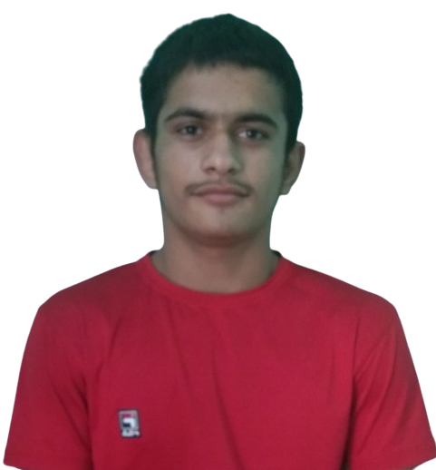
Name : Aman (Karnataka)(TOPS Development)
Event : 57 Kg FS
DOB/Age: 25/07/2005 (17 Years)
Age in 2028 Olympics: 23 (High Performance Age)
Training Base : Air Force Centre Jalhali, Bangalore
Best Performance: 3rd at 2022 Cadet Nationals
Latest performance at International:2021 Cadet WCH Gold
Aman’s predicted performance for 2028
Event | Effective Participant | Participant | Others | Need time to assess
2028 LA Olympic Games |  |  |  | ✔
Position at last Sr. Nationals (2021) | Position at last Cadet Nationals | Position at last Open Nationals | Position at last Jr. WCH | Position at last Cadet WCH | Position at Sr. ACH 2022 | Latest performance
DNP | 3 | DNP | NA | 1 | NA | 3rd in Khelo India 2022

Slide 26
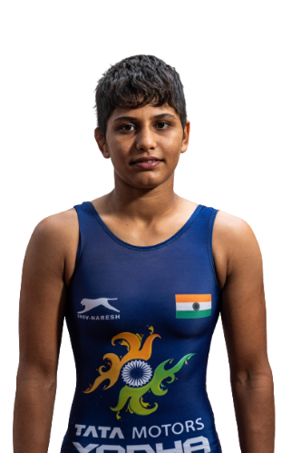
Name :Antim Panghal
Event : 53 Kg WW
DOB/Age: 31/08/2004 (18 Years)
Age in 2028 Olympics: 24 (High Performance Age)
Training Base : SAI Lucknow
Best Performance: U-20 World Championship Gold, 4th Ranking Series Tunisia, Gold
Latest performance at International:
U-20 World Championship Gold
Current UWW Rank: 37
Antim’s predicted performance for 2028 Olympic Games
Event | Effective Participant | Participant | Others | Need time to assess
2028 LA Olympic Games |  |  |  | ✔
Position at last Sr. Nationals | Position at last Jr. Nationals | Position at last Open Nationals | Position at recent Jr. WCH | Position at recent Cadet WCH | Latest performance
NA | 2022 Junior Nationals Gold | DNP | Gold at 2022 Jr. World Championship | 2021 Cadet World Champ. Bronze. | Lost to Vinesh Phogat in Sr. WCH trials final by 7-0.

Slide 27
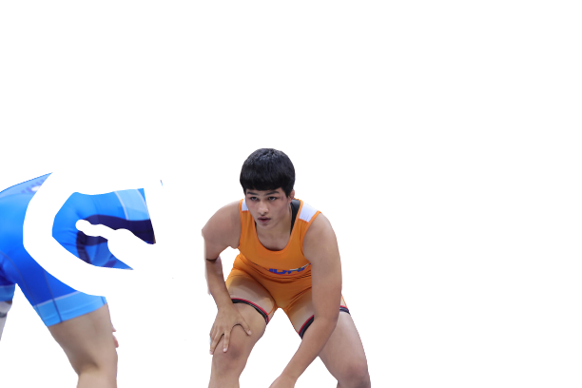
Name : Priya Malik
Event : 76 Kg WW
DOB/Age:16.02.2005 (17 Years)
Age in 2028 Olympics: 23 (Not in High Performance Age)
Training Base :
Best Performance: U-20 World Championship Silver
Latest performance at International:
U-20 World Championship Silver
Priya Malik’s predicted performance for 2028 Olympic Games
Event | Effective Participant | Participant | Others | Need time to assess
2028 LA Olympic Games |  |  |  | ✔
Position at last Sr. Nationals (2021) | Position at last Jr. Nationals | Position at last Open Nationals | Position at last Jr. WCH | Position at recent Cadet WCH | Latest performance
NA | 2022 Junior Nationals Gold | DNP | Silver at 2022 Jr. World Championship | 2021,2022 Cadet World Champ Gold medalist. | Lost by 2-1 to Japanese Wrestler in U-20 WCH final.

Slide 28
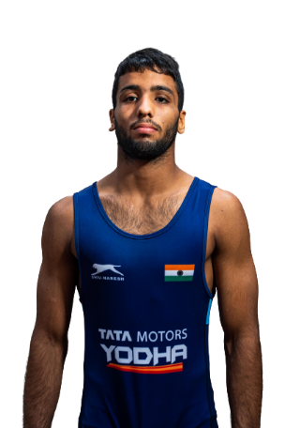
Name : Sujeet
Event : 65 Kg FS
DOB/Age: 5.11.2002 (19 Years)
Age in 2028 Olympics: 25 (High Performance Age)
Training Base : Sonipat
Best Performance: 2022 4th Ranking Series, Gold
Latest performance at International: Bronze at U-20 World Championship
Current UWW Rank: 73
Sujeet’s predicted performance for 2028 Olympic Games
Event | Effective Participant | Participant | Others | Need time to assess
2028 LA Olympic Games |  |  |  | ✔
Position at recent Sr. Nationals | Position at recent Jr. Nationals | Position at last Open Nationals | Position at last Jr. WCH | Position at last Cadet WCH | Latest performance
NA | 2022 Junior Nationals Gold, 2021 Jr. Nationals SIlver | DNP | Bronze at 2022 Jr. World Championship | 2021,2022 Cadet World Champ Gold medalist. | Lost by criteria in 70 Kg World Championship trials to Ravinder when score was 6-6. Sujeet looked tired.

Slide 29
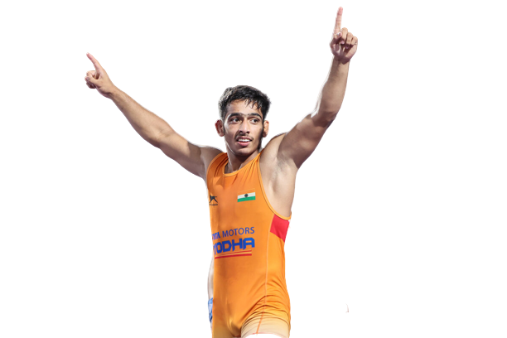
Name : Suraj Vasisth
Event : 55 Kg GR
Age: (16 Years)
Age in 2028 Olympics: 22 (High Performance Age)
Training Base :
Best Performance: 2022 U-17 World Championship Gold
Latest performance at International:
2022 U-17 World Championship Gold
Sujeet’s predicted performance for 2028 Olympic Games
Event | Effective Participant | Participant | Others | Need time to assess
2028 LA Olympic Games |  |  |  | ✔
Position at recent Sr. Nationals | Position at recent Cadet Nationals | Position at last Open Nationals | Position at last Jr. WCH | Position at last Cadet WCH | Latest performance
NA | 2022 Cadet Nationals Gold | DNP | DNP | 2022 Cadet World Champ Gold medalist. | Won U-17 WCH final by Technical Superiority against Azerbaijan wrestler who is 2022 Cadet European Champion

Slide 30
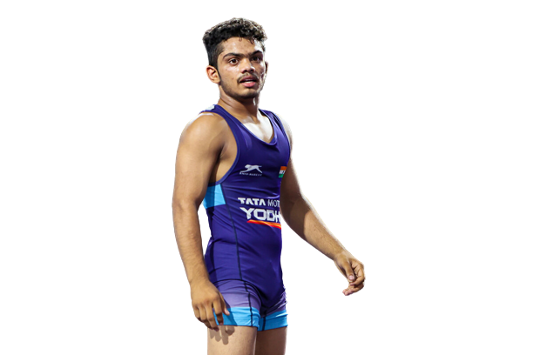
Name : Ronit Sharma
Event : 48 Kg GR
Age: 16 Years
Age in 2028 Olympics: 22 (High Performance Age)
Training Base :
Best Performance: 2022 U-17 World Championship Silver
Latest performance at International:
2022 U-17 World Championship Silver
Ronit’s predicted performance for 2028 Olympic Games
Event | Effective Participant | Participant | Others | Need time to assess
2028 LA Olympic Games |  |  |  | ✔
Position at recent Sr. Nationals | Position at recent Cadet Nationals | Position at last Jr. WCH | Position at last Cadet WCH | Latest performance
NA | 2021 Cadet Nationals Gold, DNP in 2022 | NA | 2022 U-17 World Champ Silver medalist. | Won Silver at U-17 World Championship final.

